Slide 1
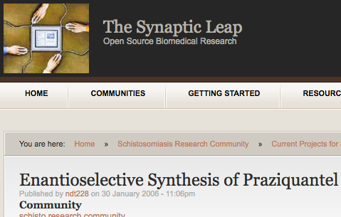
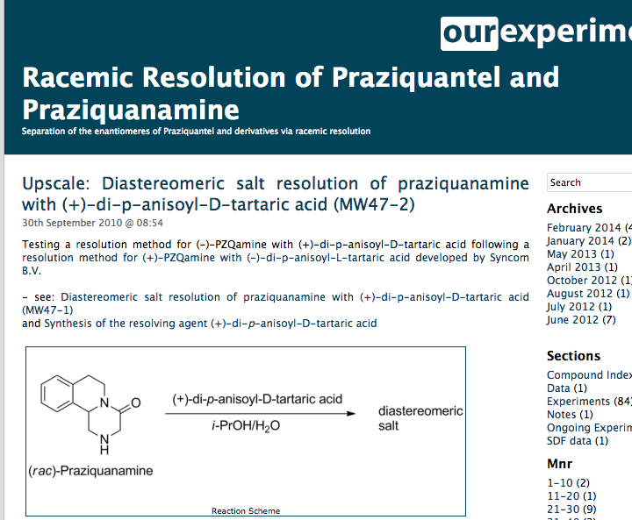
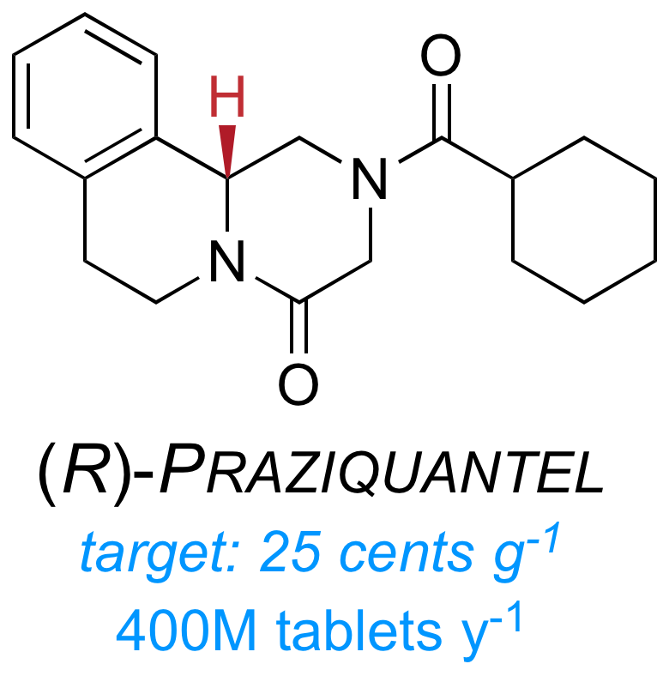

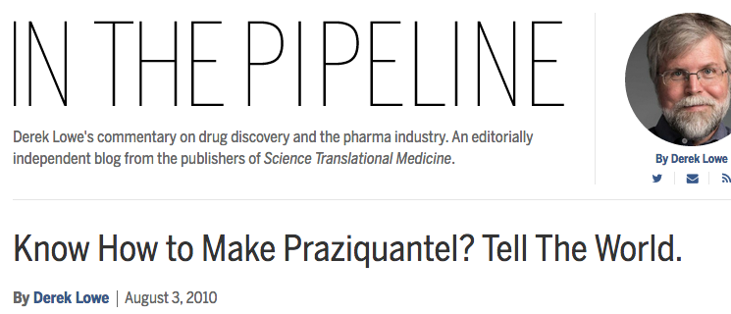


First Open Source Project - Schisto
Discuss What you Can’t Do
Online Lab Notebook
Community (30 ppl)
$, expertise
Awareness
Private Sector…

Slide 2
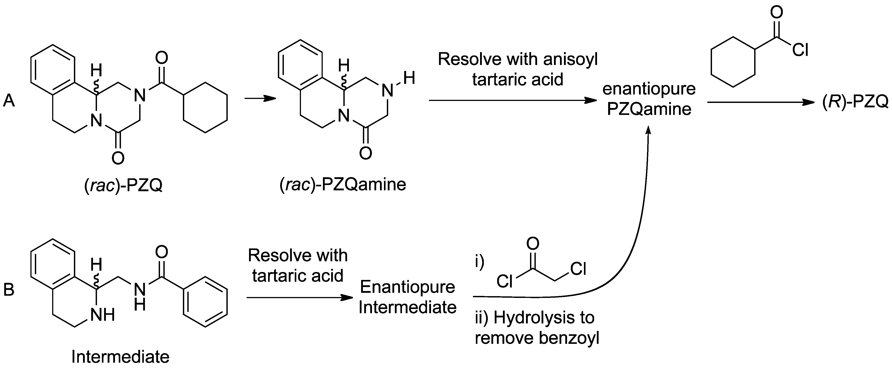


Competes with Traditional Approach
Nature Chemistry 2011, 3, 745-748; PLoS NTD 2011, 5(9): e1260

